Slide 1


Software Testing

Slide 2
Software Testing
The Testing Phase involves systematically evaluating a software product or application to ensure it meets requirements, identifies defects, and improves quality before release.
This phase typically includes various types of testing like
Unit testing
Integration testing
System testing
user acceptance testing….etc
Goals:
Verification: Have we built the software right?
Validation: Have we built the right software?

Slide 3
Software Testing
Key Objectives of the Testing Phase:
Identify Defects:
The primary goal is to uncover and fix potential errors, weaknesses, or areas for improvement before the product is launched / Deliver.
Ensure Functionality:
Verify that the software performs as intended and meets the specified requirements.
Improve Quality:
Enhance the overall quality and reliability of the software.
Reduce Risks:
Minimize the risk of problems or issues arising after the software is deployed.

Slide 4
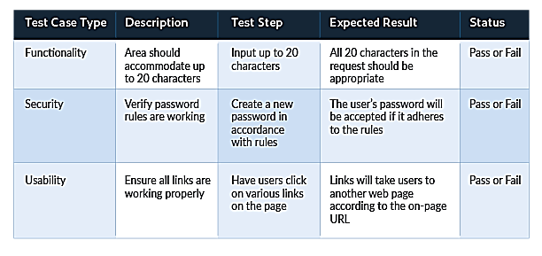
Software Testing
Six phases of the Software Testing Life Cycle (STLC):
Requirement Analysis: This phase involves understanding the requirements of the software, including functional and non-functional requirements.
Test Planning: A plan is developed outlining the scope, objectives, and resources for testing, including identifying requirements, determining the target audience, selecting appropriate testing tools and methods, defining roles and responsibilities, and defining timelines.
Test Case Design: Test cases are designed to cover various aspects of the software and ensure that all requirements are tested. (A "test case" in software testing is a detailed document outlining a specific scenario to be tested, including input, expected output, and execution steps, to verify a software application's functionality and ensure it meets requirements)

Slide 5
Software Testing
Phases of the Software Testing Life Cycle (STLC):
Test Environment Setup: The necessary environment is set up to execute the test cases, including hardware, software, and data.
Test Execution: The designed test cases are executed, and the results are recorded.
Test Closure: The testing process is closed, and a final report is prepared summarizing the findings.

Slide 6
Software Testing
Types of Testing:
Unit Testing: Testing individual components or modules of the software.
Integration Testing: Testing the interaction between different modules or components.
System Testing: Testing the entire system as a whole to ensure it meets the requirements.
User Acceptance Testing (UAT): Testing by end-users to ensure the software meets their needs and expectations.
Performance Testing: Evaluating the software's performance under different conditions such as speed, scalability, and stability.
Security Testing: Assessing the software's security vulnerabilities.
Static Testing: Reviewing code and documentation without executing the software.
Dynamic Testing: Executing the software and observing its behavior.
Regression testing – Tests the software after changes or modifications have been made to ensure the changes have not introduced new defects.

Slide 7
Software Testing
Benefits of Effective Testing:
Improved Software Quality: Ensures the software is reliable and meets the requirements.
Reduced Development Costs: Identifying and fixing defects early in the development lifecycle can save time and money.
Increased Customer Satisfaction: Delivering a high-quality product leads to happier customers.
Enhanced Reputation: A strong reputation for delivering quality software can lead to more business opportunities.

Slide 8
Software Testing
Types of Test Plan in Software Testing
There are three types of test plans:
Master Test Plan: This includes the overall plan, roadmap, and software testing life cycle outline.
Phase Test Plan: As a test plan gets converted to a sprint. Here the focus is on one sprint at a time.
Specific Test Plan: This test plan is around a particular test case scenario or tool. It has details of that one functionality and how it should be tested.

Slide 9
Types of tests
Software Testing
White Box testing requires developers with code expertise, examines code and logic
Black Box testing can be performed by testers without coding knowledge, this type of testing focuses on functionality without internal knowledge
Grey Box testing is particularly effective when security vulnerabilities must be tested, as it combines both functional and partial internal knowledge for targeted testing.

Slide 10
Types of tests
Software Testing
White Box testing requires developers with code expertise, examines code and logic
Black Box testing can be performed by testers without coding knowledge, this type of testing focuses on functionality without internal knowledge
Grey Box testing is particularly effective when security vulnerabilities must be tested, as it combines both functional and partial internal knowledge for targeted testing.

Slide 11
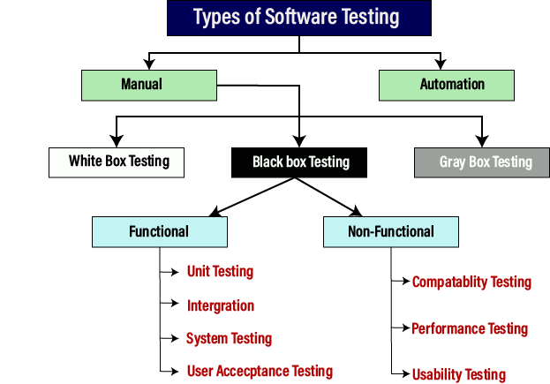
Software Testing

Slide 12
Black box testing
Software Testing
input
output
interface
Unit Testing: Testing individual components or modules of the software.
Integration Testing: Testing the interaction between different modules or components.
System Testing: Testing the entire system as a whole to ensure it meets the requirements.
User Acceptance Testing (UAT): Testing by end-users to ensure the software meets their needs and expectations.
Performance Testing: Evaluating the software's performance under different conditions such as speed, scalability, and stability.
Security Testing: Assessing the software's security vulnerabilities.
Static Testing: Reviewing code and documentation without executing the software.
Dynamic Testing: Executing the software and observing its behavior.
Regression testing – Tests the software after changes or modifications have been made to ensure the changes have not introduced new defects.

Slide 13
Software Testing
Black box testing
input
output
interface
Advantage:
Simulates Real-World Usage: Testers test the software as end-users would, focusing on how it behaves in real-world scenarios.
Independent of Implementation: Testers don't need to understand the code or internal workings, making it easier to train and utilize testers.
Disadvantage:
Limited Coverage: Black box testing may not identify all potential issues, especially those related to internal logic or code structure.
Requires Thorough Requirements: Accurate and complete specifications are critical for effective black box testing.

Slide 14
White box testing
Software Testing
Types of White Box Testing:
  Path Testing: Tests all possible paths through the code.
  Loop Testing: Focuses on testing the loops within the application.
  Data Flow Testing: Tracks the flow of data within the code.
  Mutation Testing: Introduces small changes to the code to ensure that the test suite can detect them.

Slide 15
White box testing
Software Testing
Advantages of White-Box Testing:
Comprehensive Code Coverage:
White-box testing allows testers to examine every line of code and every possible path through the application, ensuring thorough testing.
Early Defect Detection:
By testing the internal logic and structure, white-box testing can identify defects and vulnerabilities early in the development process, reducing costs and effort later.
Improved Code Quality:
White-box testing helps identify and fix code errors, leading to improved code quality and reliability.
Code Optimization:
White-box testing can reveal hidden errors and inefficiencies, enabling developers to optimize the code and improve performance.
Test Case Automation:
Test cases can be easily automated, which speeds up the testing process and reduces manual effort.
Security Vulnerability Identification:
White-box testing can help identify security vulnerabilities in the code, such as coding errors that could allow malicious attackers to access sensitive data or gain access to the system.
Disadvantages of White-Box Testing:
High Cost:
White-box testing requires skilled testers with programming knowledge, which can increase the cost of testing.
Time-Consuming:
Developing and executing white-box test cases can be time-consuming, especially for large and complex applications.
Requires Deep Understanding:
Testers need a deep understanding of the internal structure and code of the application, which can be challenging.
Maintenance Burden:
Test cases can become outdated quickly if the code changes, requiring significant effort to maintain and update them.
Not Suitable for All Applications:
White-box testing may not be suitable for all types of applications, especially those with complex or dynamic interfaces.
May Miss User-Facing Issues:
Test cases are based on implementation details, which can make them less effective at identifying user-facing issues or usability problems.

Slide 16
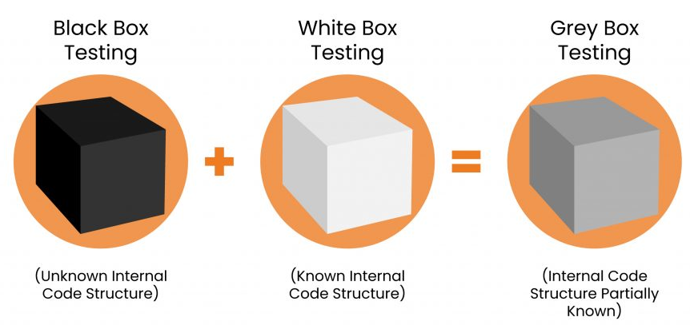
Gray box testing
Software Testing
Gray box testing aims to:
Identify defects due to improper structure or usage of applications.
Evaluate functionality and security.
Understand how the program responds to users.
Identify errors in functionality.
Assess overall quality.
Benefits:
More targeted and efficient testing compared to black box testing.
Can identify security vulnerabilities by simulating the perspective of an attacker with some insider knowledge.
Helps in understanding how the application behaves under real-world scenarios.

